Slide 2
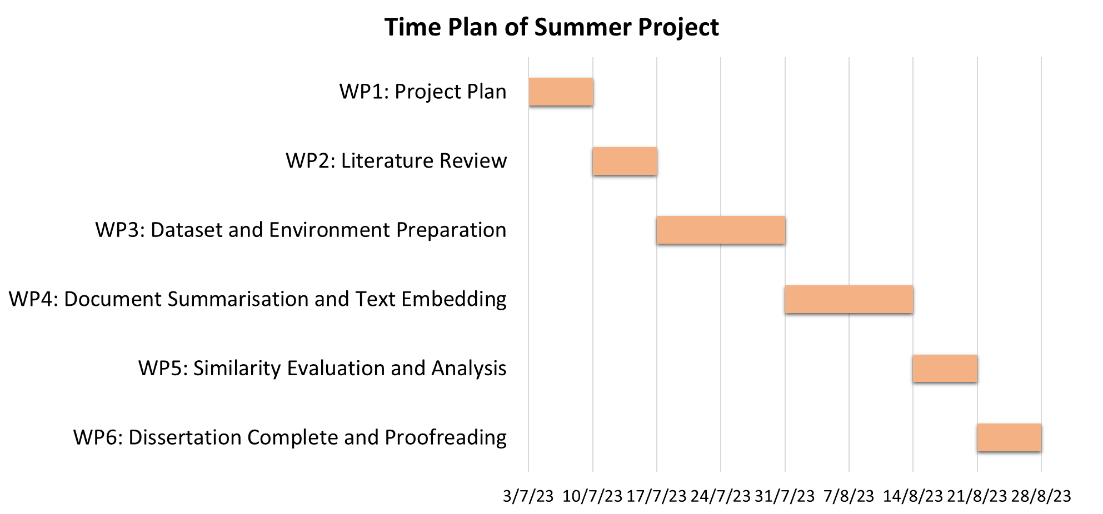
Week 1
☑ project plan
Week 2
☑ introduction and literature review
Week 3, 4
☑ material
Week 5, 6
☑ material and method
Week 7
☑ result and analysis
Week 8
☑ conclusion and discussion

